Slide 1
Chapter 1: Introduction to Computers, Programs, and Java

Slide 2
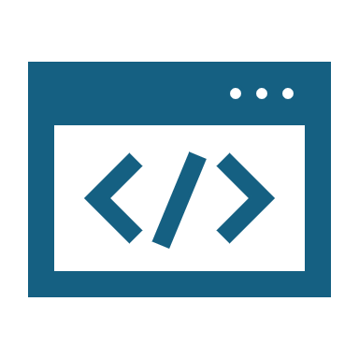
Objectives
To understand computer basics, programs, and operating systems.
To describe the relationship between Java and the World Wide Web.
To understand the meaning of Java language specification, API, JDK, and IDE.
To write a simple Java program.
To display output on the console.
To explain the basic syntax of a Java program.
To create, compile, and run Java programs.
To use sound Java programming style and document programs properly.
To explain the differences between syntax errors, runtime errors, and logic errors.

Slide 3
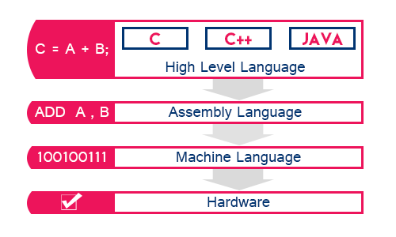
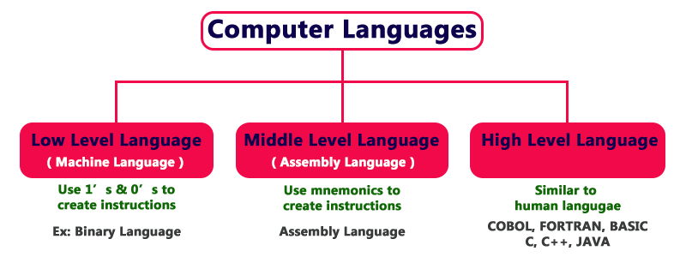
Computer Language

Slide 4
Popular High-Level Languages

Slide 5
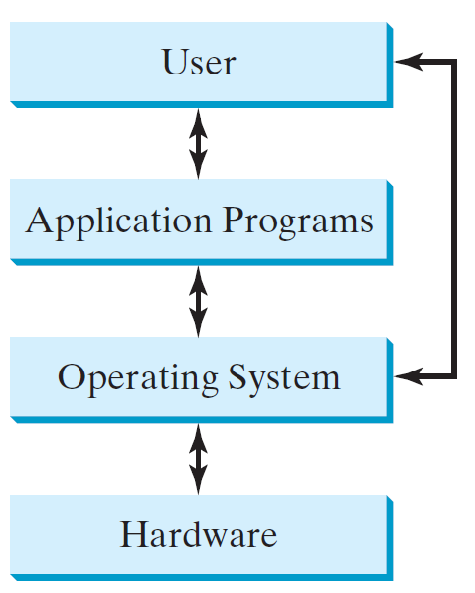
Operating Systems
The operating system (OS) is a program that manages and controls a computer’s activities. The popular operating systems for general-purpose computers are Microsoft Windows, Mac OS, and Linux. Application programs, such as a Web browser or a word processor, cannot run unless an operating system is installed and running on the computer.

Slide 6
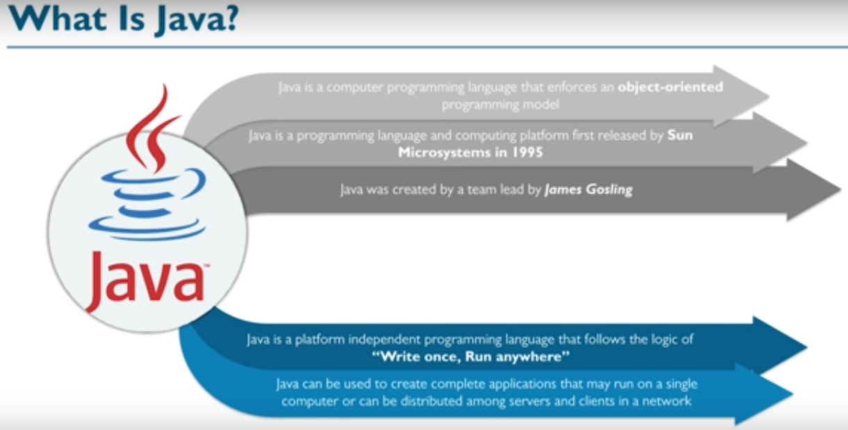

Slide 7
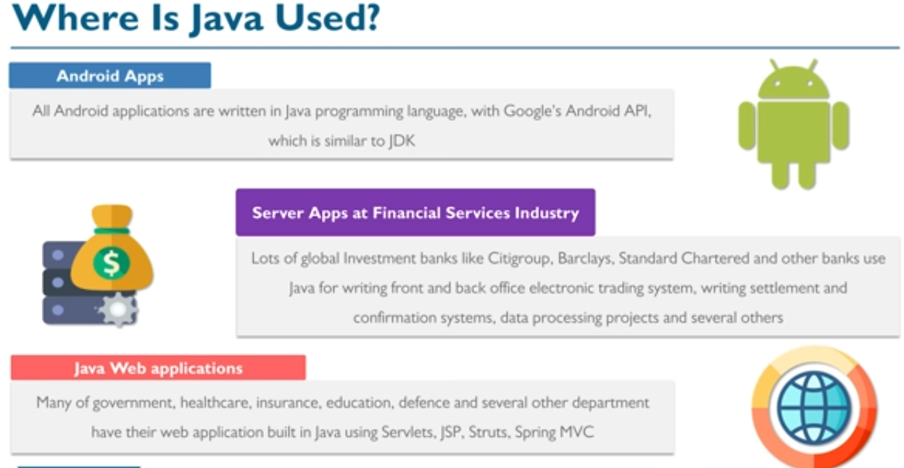

Slide 8
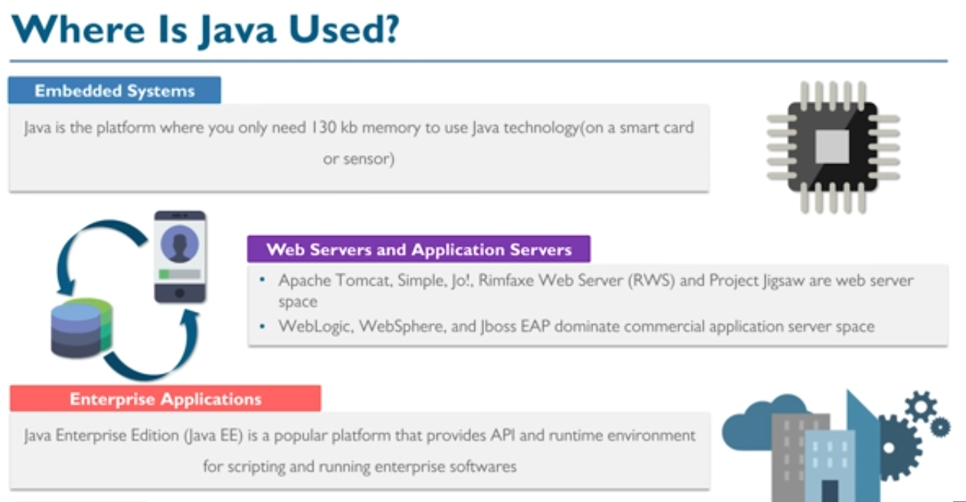

Slide 9
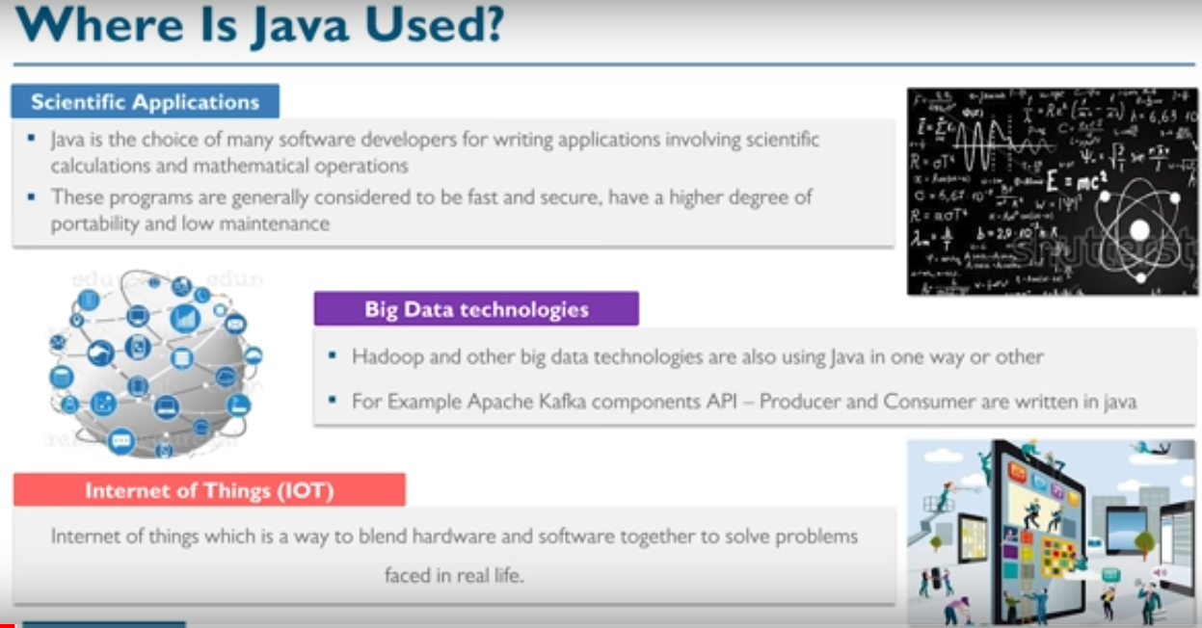

Slide 10

Inner working of Java Program
When you run the Java program, Java compiler first compiles your Java code to bytecode. Then, the Java Virtual Machine (JVM) translates bytecode into native machine code (set of instructions that a computer's CPU executes directly).

Slide 11
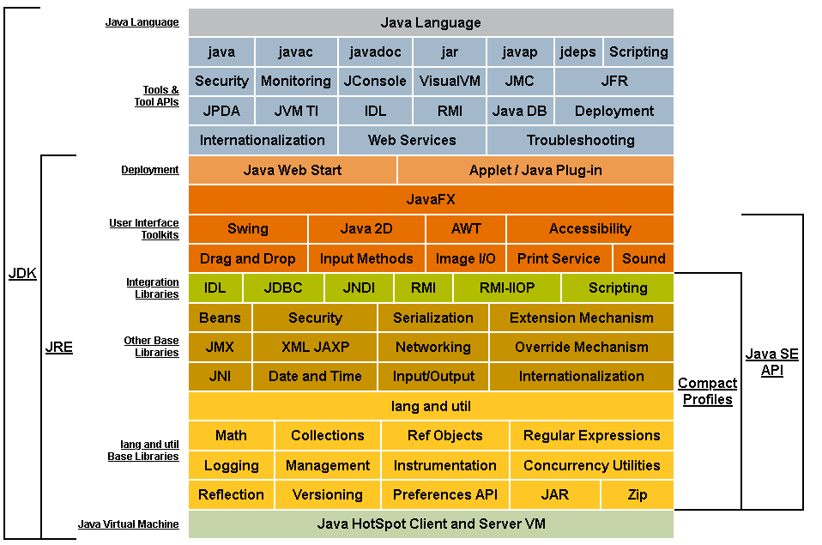
Description of Java Conceptual Diagram

Slide 12
JAVA Environment Setup
We need to Download:
Java Development Kit (JDK). https://www.oracle.com/java/technologies/javase/javase-jdk8-downloads.html
Integrated Development Environment (IDE) Software : Example: NetBeans , IntelliJ , or Eclipse,
For Online Code Compilers:
CodingGround
OnlineGDB
Ideone
Programiz

Slide 13
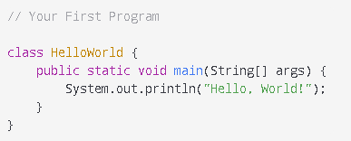
Sample Java Program
Many ways can be used to write/run java programs; through IDE, or commandline
Notes:
public - access modifier. It means the method can be accessed from anywhere.
static - It means that the method can be accessed without any objects.
void - It means that the method does not return any value.

Slide 14
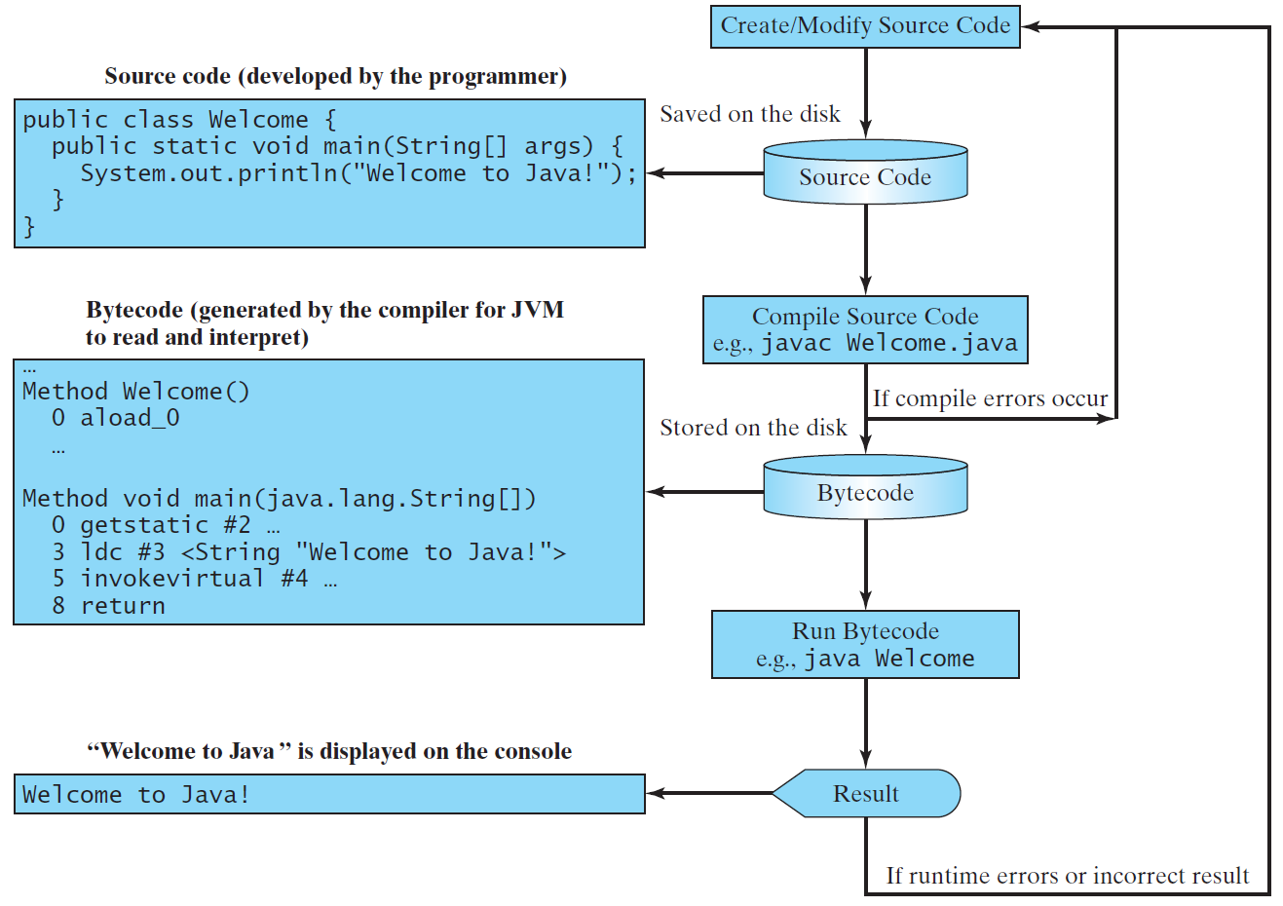
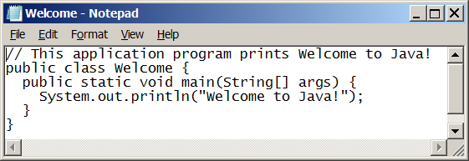
Creating, Compiling, and Running Programs

Slide 15
Anatomy of a Java Program
Class name
Main method
Statements
Statement terminator
Reserved words
Comments
Blocks

Slide 16
Class Name
Every Java program must have at least one class. Each class has a name. By convention, class names start with an uppercase letter. In this example, the class name is Welcome.
// This program prints Welcome to Java!
public class Welcome {
public static void main(String[] args) {
System.out.println("Welcome to Java!");
}
}

Slide 17
Main Method
Line 2 defines the main method. In order to run a class, the class must contain a method named main. The program is executed from the main method.
// This program prints Welcome to Java!
public class Welcome {
public static void main(String[] args) {
System.out.println("Welcome to Java!");
}
}

Slide 18
Statement
A statement represents an action or a sequence of actions. The statement System.out.println("Welcome to Java!") in the program in Listing 1.1 is a statement to display the greeting "Welcome to Java!“.
// This program prints Welcome to Java!
public class Welcome {
public static void main(String[] args) {
System.out.println("Welcome to Java!");
}
}

Slide 19
Statement Terminator
Every statement in Java ends with a semicolon (;).
// This program prints Welcome to Java!
public class Welcome {
public static void main(String[] args) {
System.out.println("Welcome to Java!");
}
}

Slide 20
Reserved words
Reserved words or keywords are words that have a specific meaning to the compiler and cannot be used for other purposes in the program. For example, when the compiler sees the word class, it understands that the word after class is the name for the class.
// This program prints Welcome to Java!
public class Welcome {
public static void main(String[] args) {
System.out.println("Welcome to Java!");
}
}

Slide 21
Blocks
A pair of braces in a program forms a block that groups components of a program.

Slide 22
Special Symbols

Slide 23
Best Practices for writing Java codes
Appropriate Comments : Include a summary at the beginning of the program to explain what the program does, its key features, its supporting data structures, and any unique techniques it uses.
Naming Conventions : Choose meaningful and descriptive names.
Capitalize the first letter of each word in the name. For example, the class name ComputeExpression or HelloWorld.

Slide 24
Best Practices for writing Java codes
Proper Indentation and Spacing Lines: Indent two spaces and use blank line to separate segments of the code.
Block Styles: generally stick to next-line style or end-of-line style.

Slide 25
3 common Programming Errors
Syntax Errors
Detected by the compiler
Runtime Errors
Causes the program to abort
Logic Errors
Produces incorrect result

Slide 26
Syntax Errors
public class ShowSyntaxErrors {
public static main(String[] args) {
System.out.println("Welcome to Java);
}
}

Slide 27
Runtime Errors
public class ShowRuntimeErrors {
public static void main(String[] args) {
System.out.println(1 / 0);
}
}

Slide 28
Logic Errors
public class ShowLogicErrors {
public static void main(String[] args) {
System.out.print("Celsius 35 is ");
System.out.print("Fahrenheit ");
System.out.println((9 / 5) * 35 + 32);
}
}

